Slide 1
Programming with PHP
PHP & MySQL for Dynamic Web Sites

Slide 2
What You Will Learn
Creating an HTML Form
Handing an HTML Form
Conditional and Operators
Validating Form Data
Introducing Arrays
For and While Loops

Slide 3
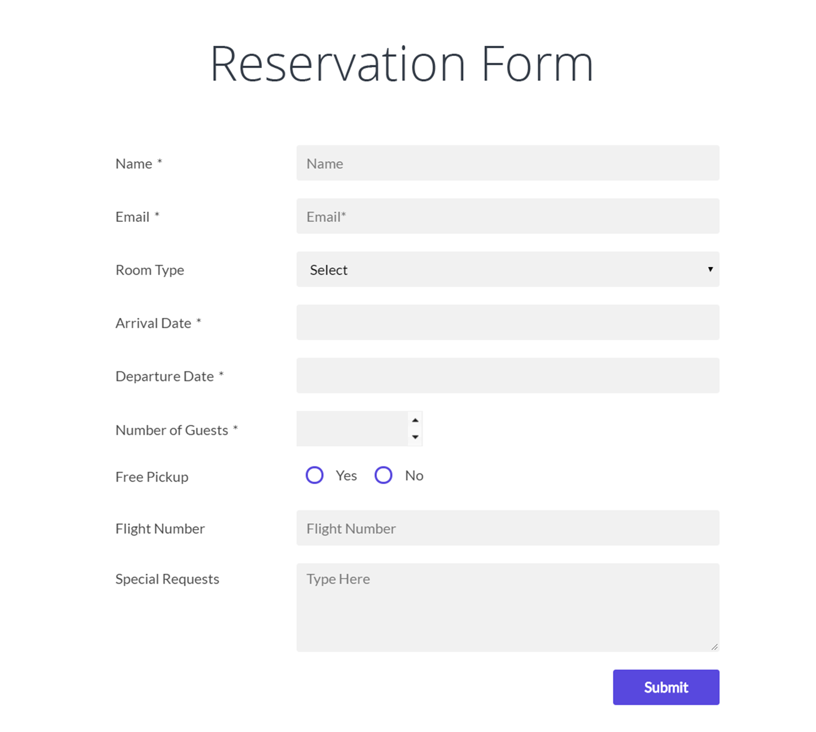



Creating an HTML Form
Process
Store
(or do something else)
Html form

Slide 4
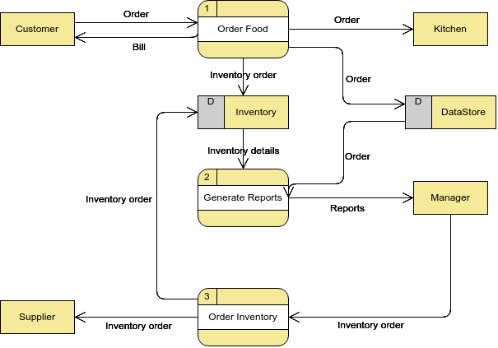
Creating an HTML Form
Process
Data Flow
External Entity
Data Store

Slide 5
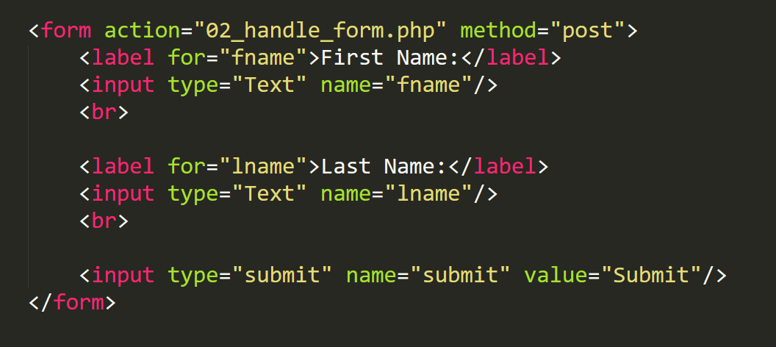
HTML Form Attributes and Elements
How to
Form attributes
Action
Enctype
Form elements
Text
Textarea
Radio
Select
File
Button
Where to

Slide 6
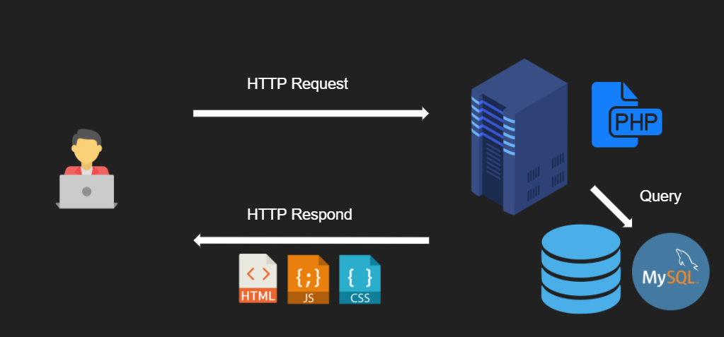
Handling Form Data
$_GET
$_POST
$_REQUEST
$_GET/ $_POST/ $_REQUEST
Get / Post/ Put / Delete

Slide 7
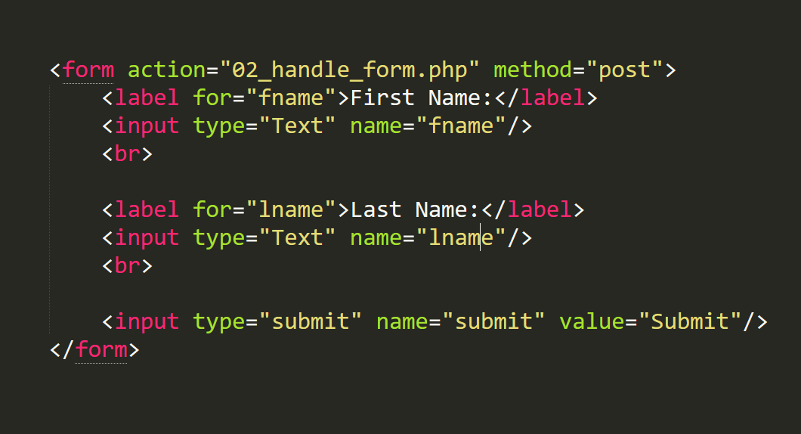
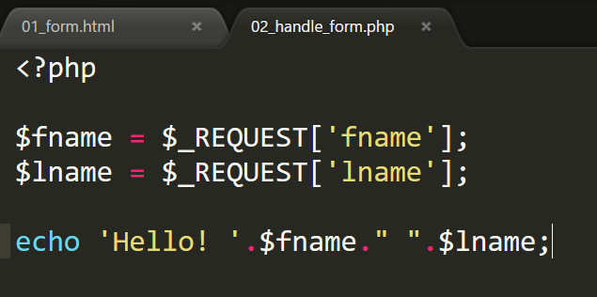
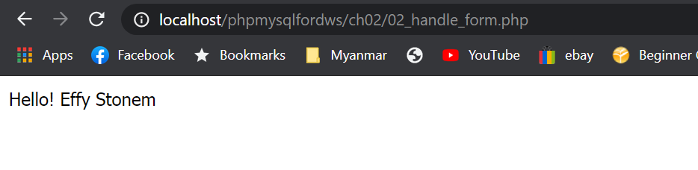
Handling Form Data
Back end script
Front end script
Output

Slide 8
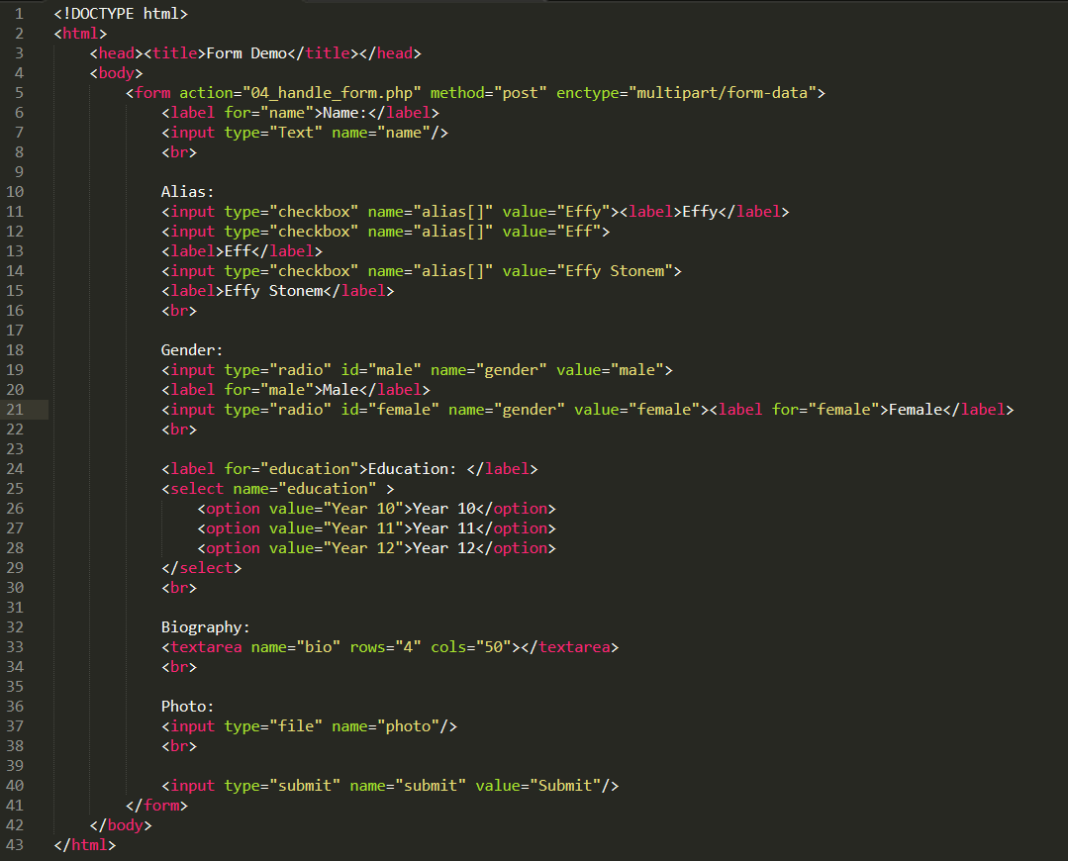
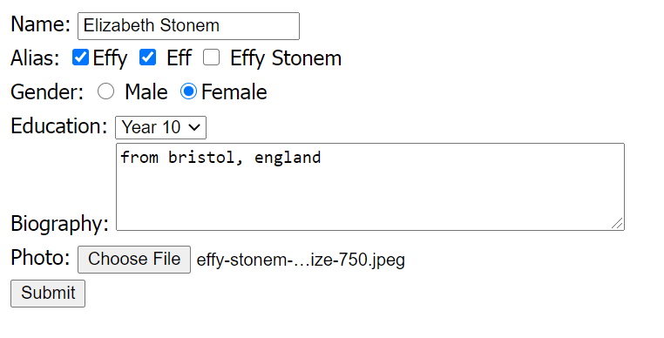
Example: Profile Form

Slide 9
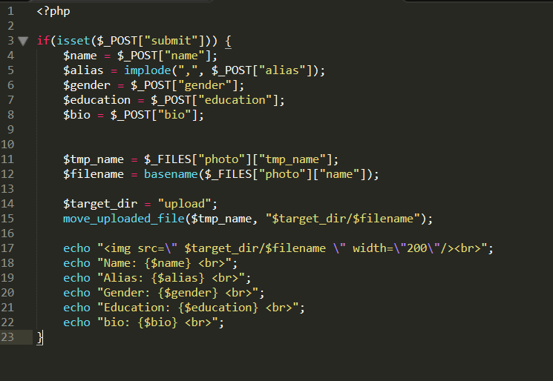
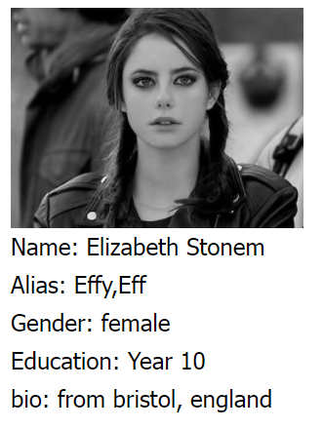
Example: Profile Form

Slide 10
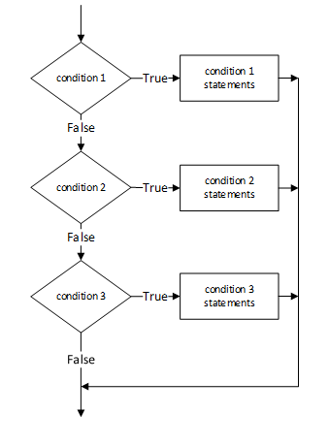
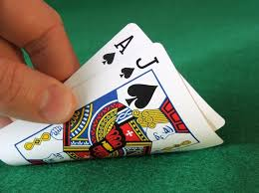
Conditional and Operators
If
Else
Elseif
IF it is greater than 21, THEN you are busted.

Slide 11
Conditionals and Operators
Comparative Operators
Equal to ( a == b )
Not equal to ( a != b )
Greater than ( a > b )
Less than ( a < b )
Greater than and equal to ( a >= b)
Less than and equal to ( a <= b)

Slide 12
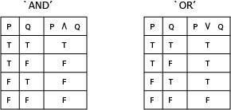
Conditionals and Operators
Logical Operators
Not ( !True )
And ( True && True, True and True )
Or ( True || False, True or False)

Slide 13
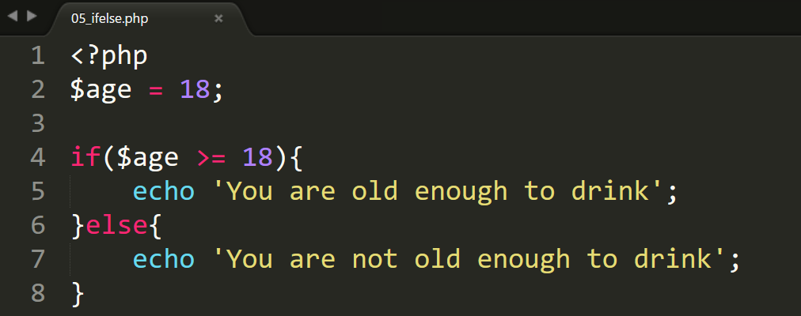
Example: IF ELSE

Slide 14
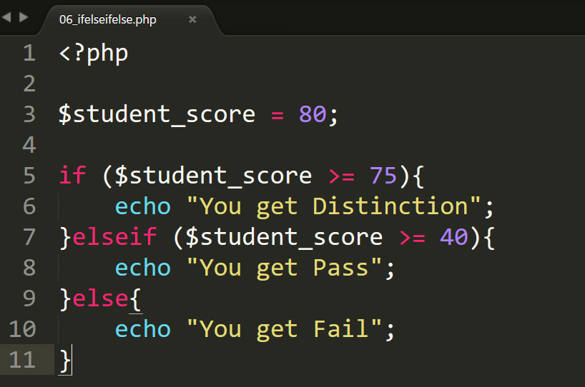
Example: IF ESLEIF ELSE
Beware of logic error in the order of your if else.
Or make sure only one block satisfies your condition.

Slide 15
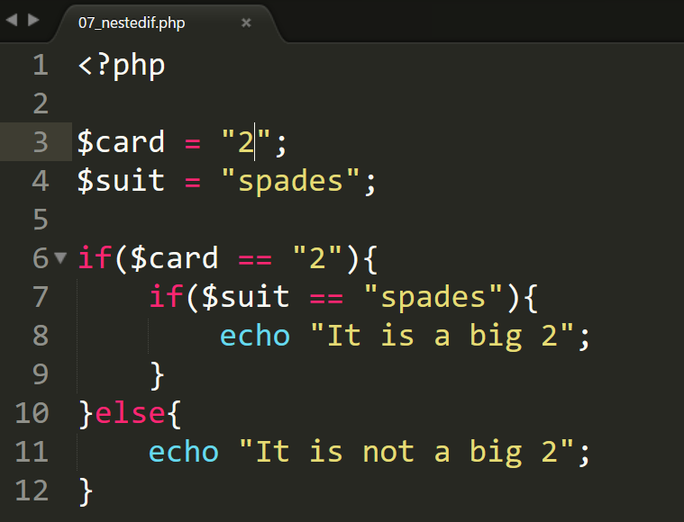
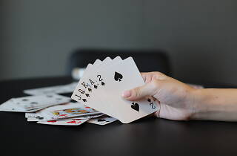
Example: Nested If

Slide 16
Validating Form Data
Never trust user input
Best to validate data in both frontend (html,js) and backend.
Always validate (empty data, format etc) and sanitize external input (trim, htmlspecialchars, htmlentities, etc). You can write your own code or use functions.
FILTER_VALIDATE_INT, FILTER_VALIDATE_EMAIL
trim()
htmlspecialchars()
htmlentities()

Slide 17
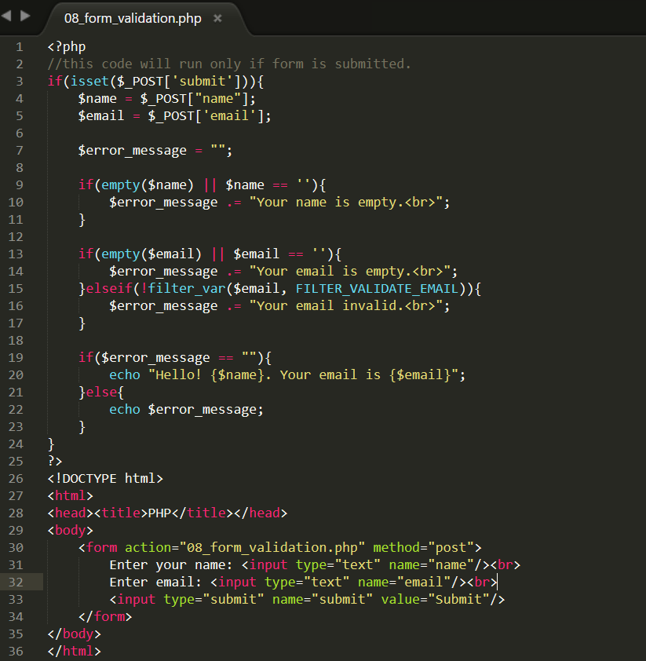
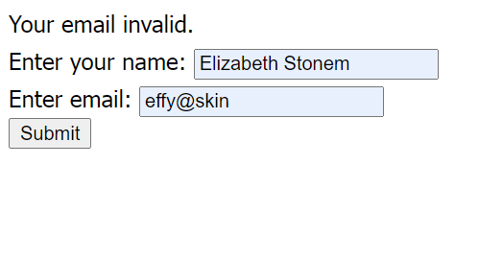
Example: Validate Form Data

Slide 18
Introducing Array
An array is a collection of data values organized as an ordered collection of key-value pairs.
Two kinds of array: Indexed and Associative.

Slide 19
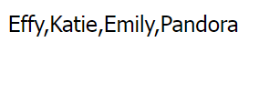
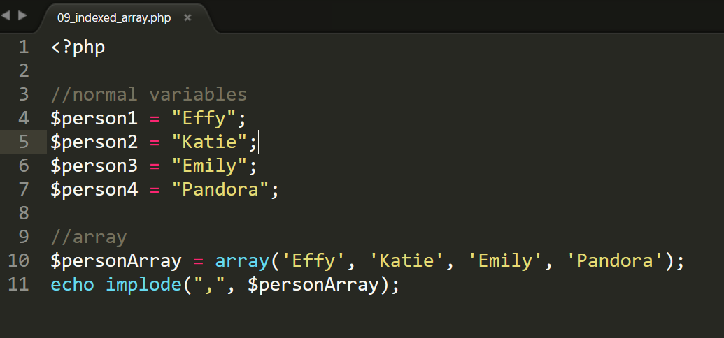
Indexed Array

Slide 20
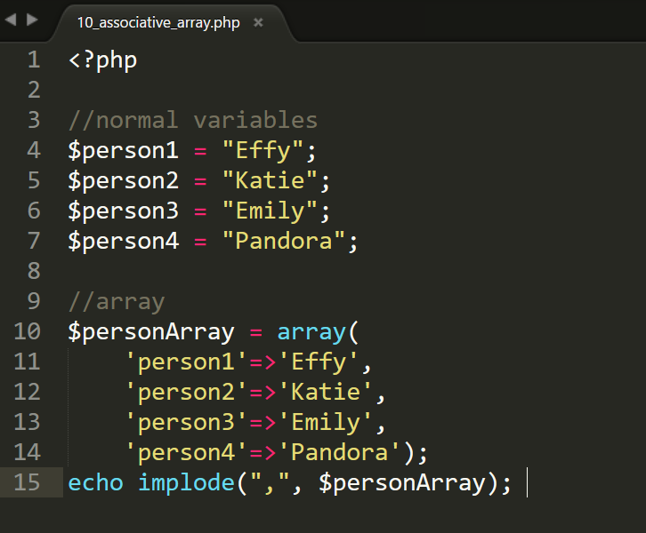
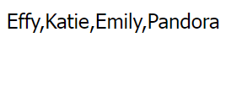
Associative Array

Slide 21
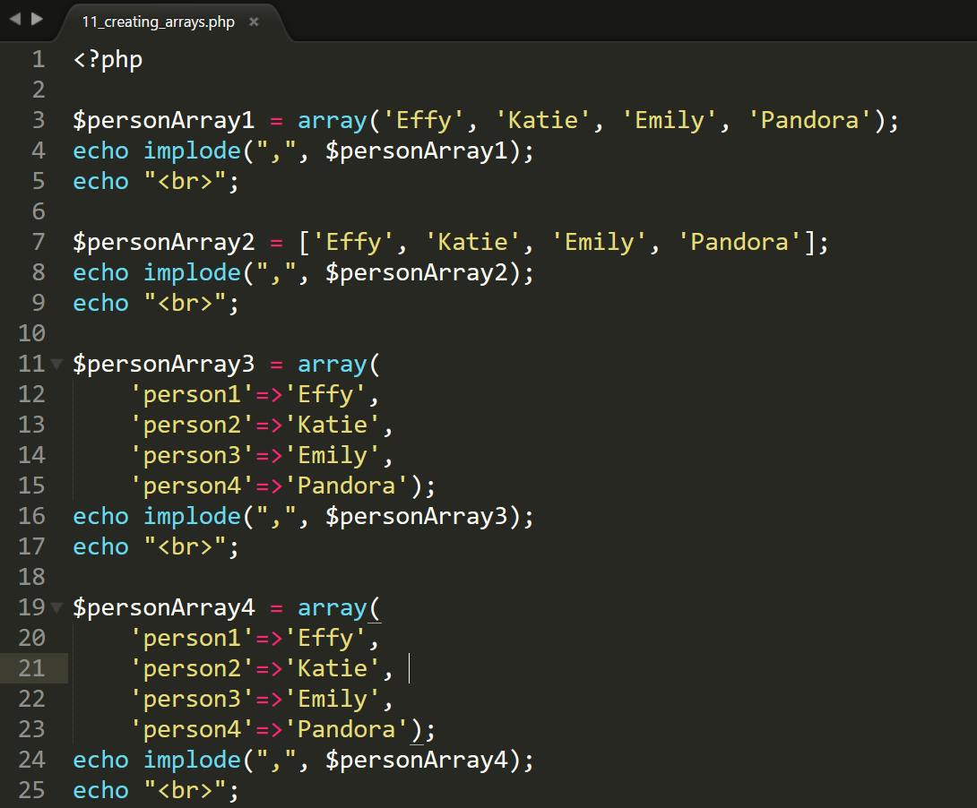
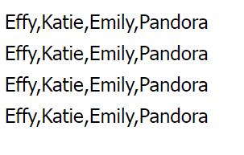
Creating Arrays

Slide 22
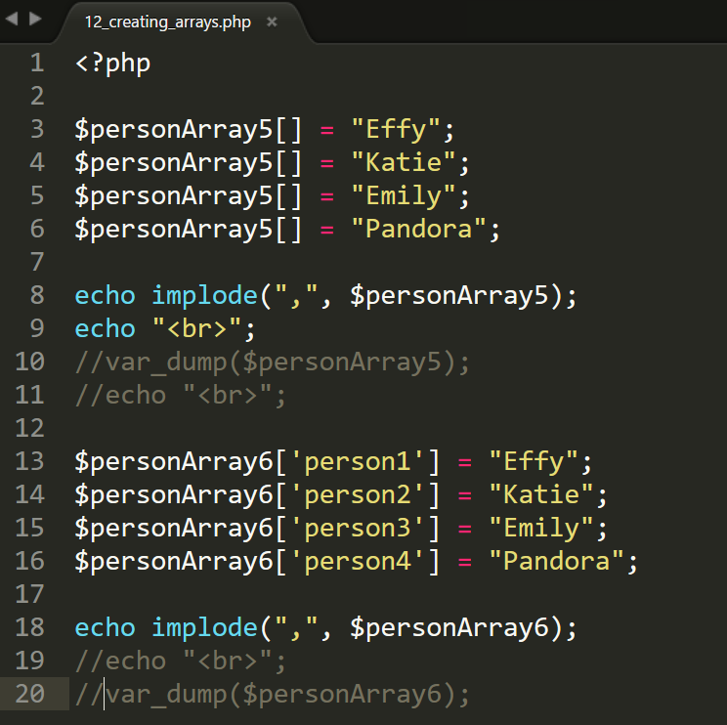
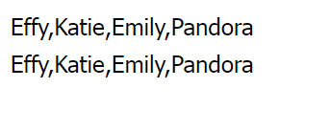
Creating Arrays: An Element at a Time

Slide 23
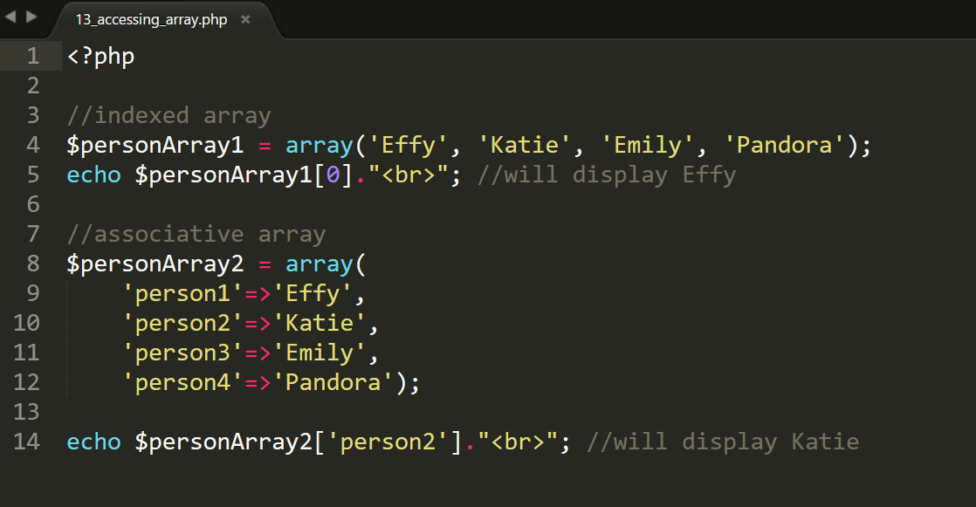
Accessing Array: Output an Element

Slide 24
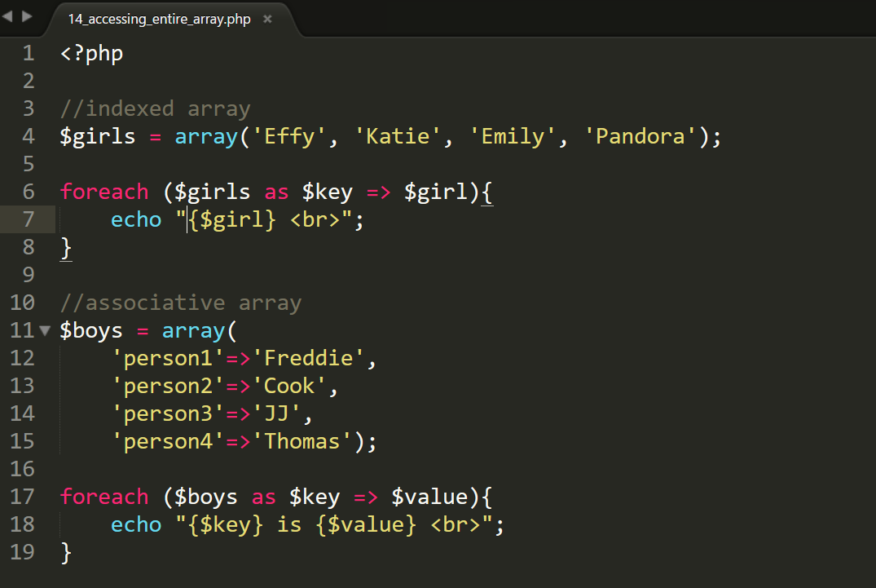
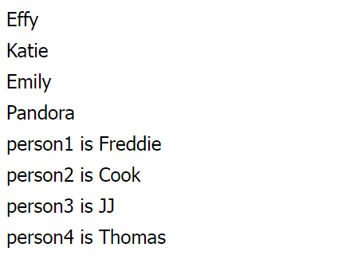
Accessing Array: Output Entire Array

Slide 25
Multidimensional Array
An array consisting of other arrays
$array = array( array(), array(), array() );
$array = [ [ ], [ ], [ ] ];

Slide 26
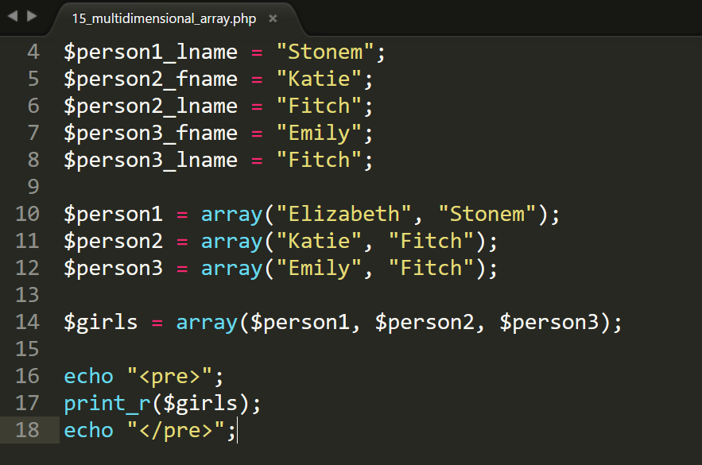
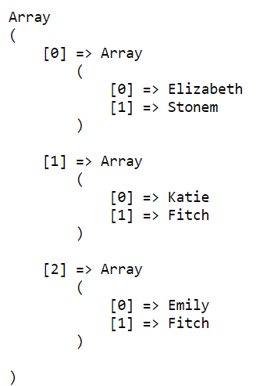
Example: Multidimensional Array

Slide 27
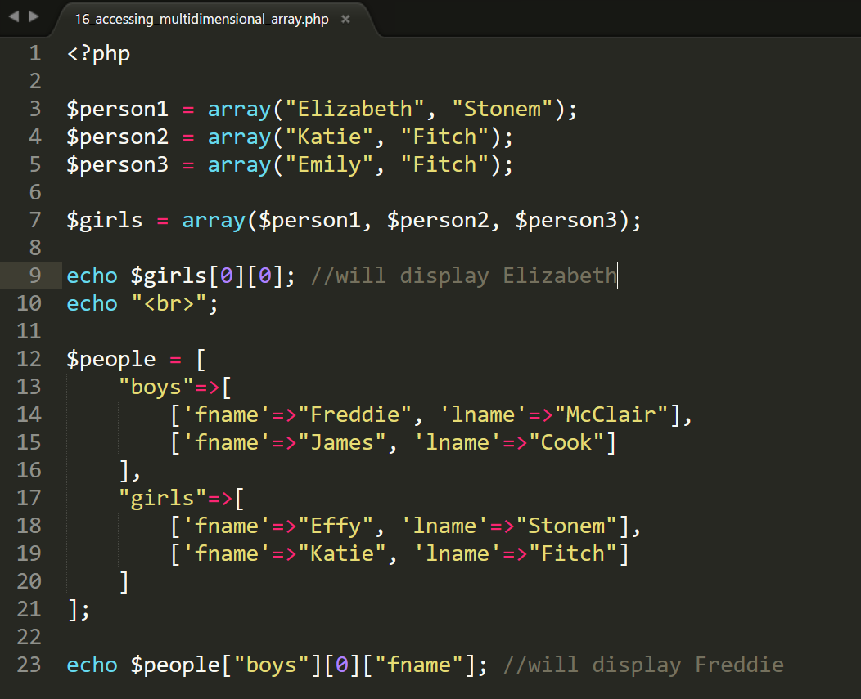
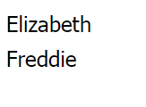
Example: Accessing Multidimensional Array

Slide 28
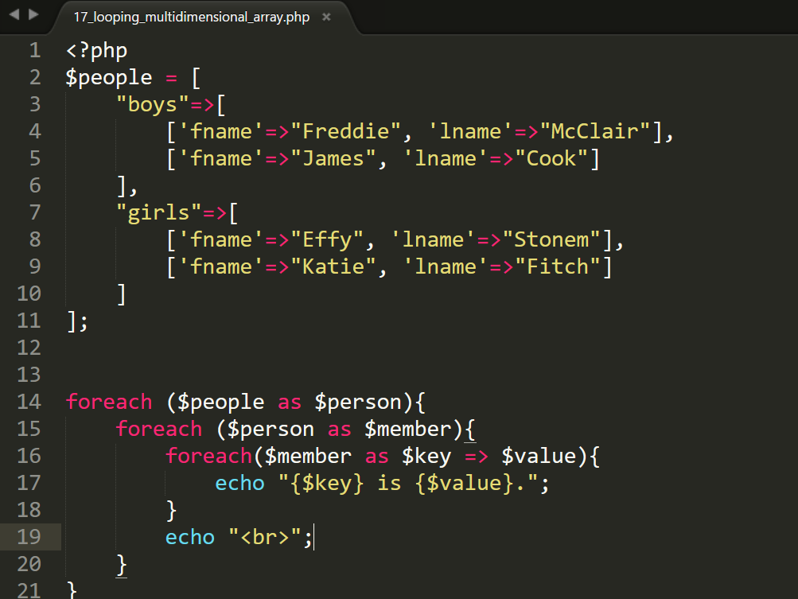
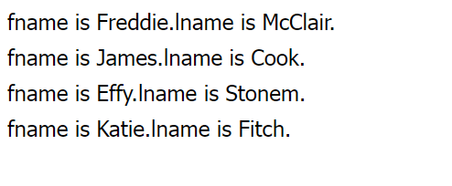
Example: Looping Multidimensional Array

Slide 29
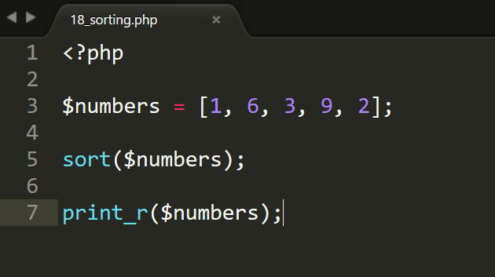
Array Functions : Sorting
Notice the indexes are changed

Slide 30
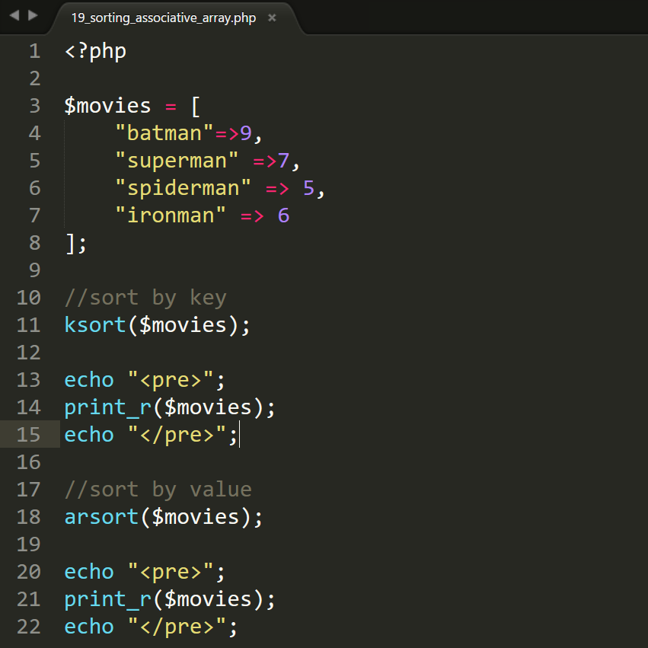
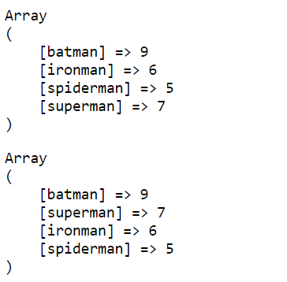
Example: Sorting Key and Value

Slide 31
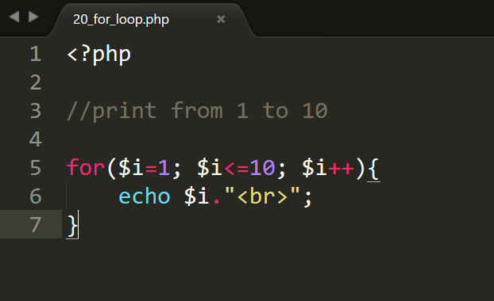
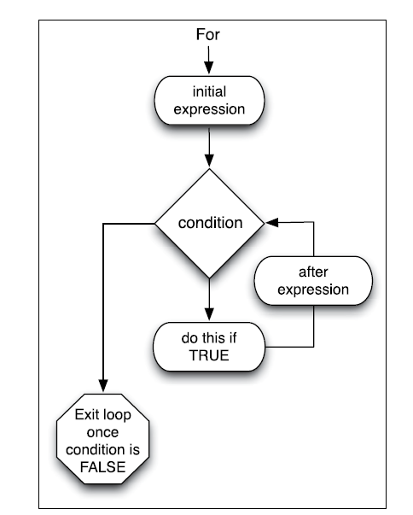
For Loop

Slide 32
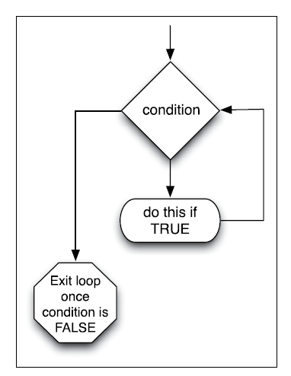
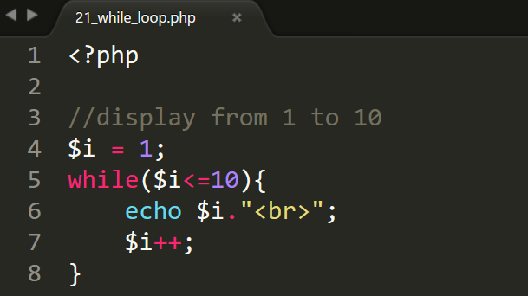
While Loop

Slide 33
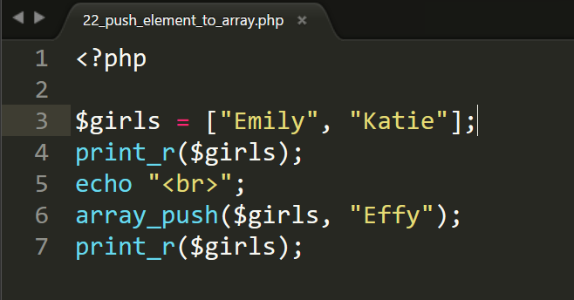
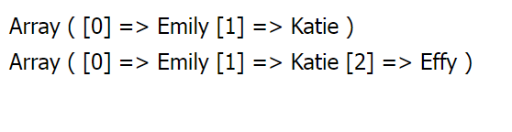
Array Function: array_push()

Slide 34
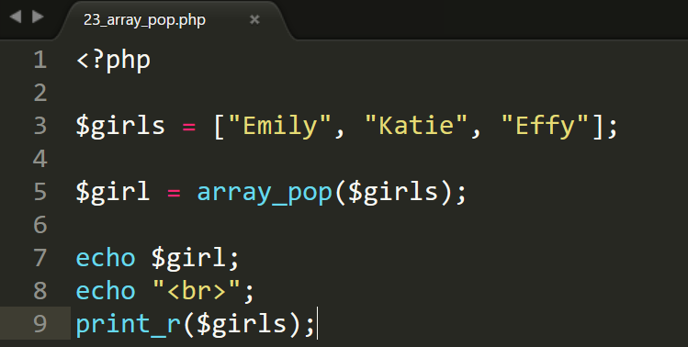
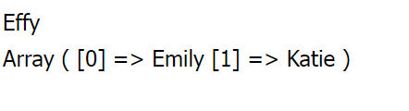
Array Function: array_pop()

Slide 35
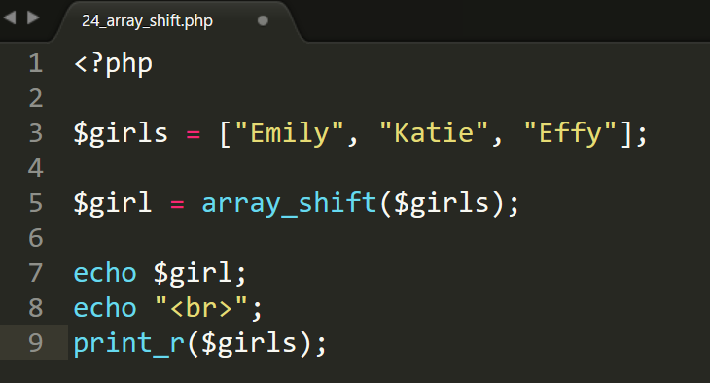
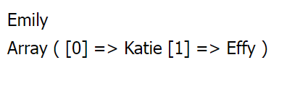
Array Function: array_shift

Slide 36


Array Function: array_slice

Slide 37


Array Function: array_splice

Slide 38


Array Function: count();

Slide 39


Array Function: in_array and array_search

Slide 40

Exercise 1
If the player exceeds a sum of 21 ("busts"), the player loses, even if the dealer also exceeds 21.
If the dealer exceeds 21 ("busts") and the player does not, the player wins.
If the player attains a final sum higher than the dealer and does not bust, the player wins.
If both dealer and player receive a blackjack or any other hands with the same sum called a "push", no one wins.

Slide 41

Exercise 2
Write a program that check a number and display whether it is odd or even number

